Slide 1
Weeks 1&2 Exercise
Andrea Fox
December 12, 2020
Bellevue University
DSC640 – Data Presentation & Visualization

Slide 2
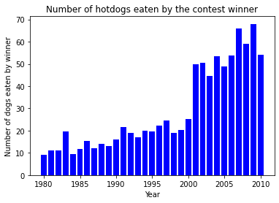
Python – Bar Chart

Slide 3
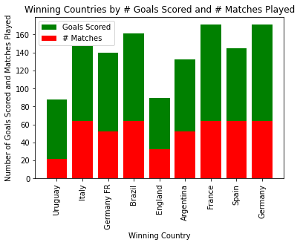
Python – Stacked Bar Chart

Slide 4
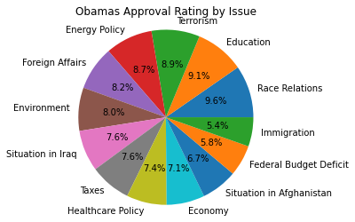
Python – Pie Chart

Slide 5
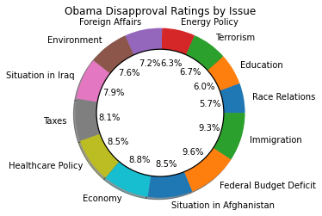
Python – Donut Chart

Slide 6
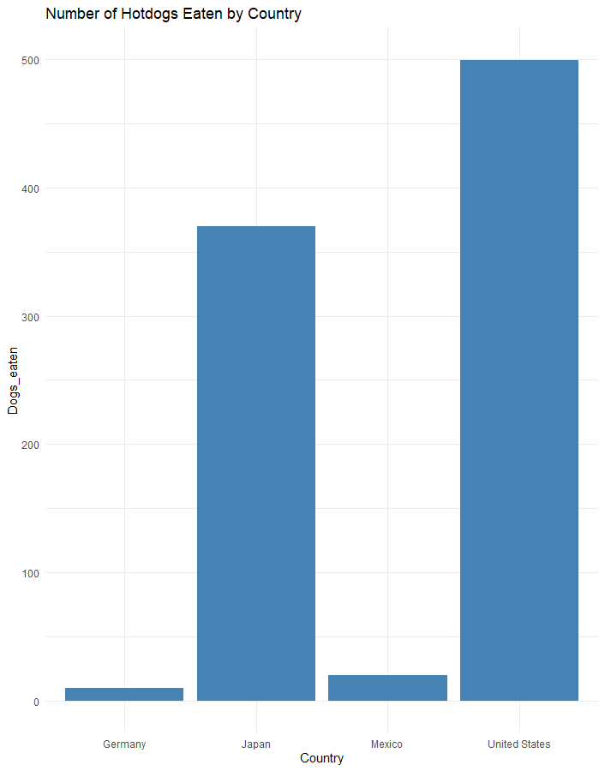
R – Bar Chart

Slide 7
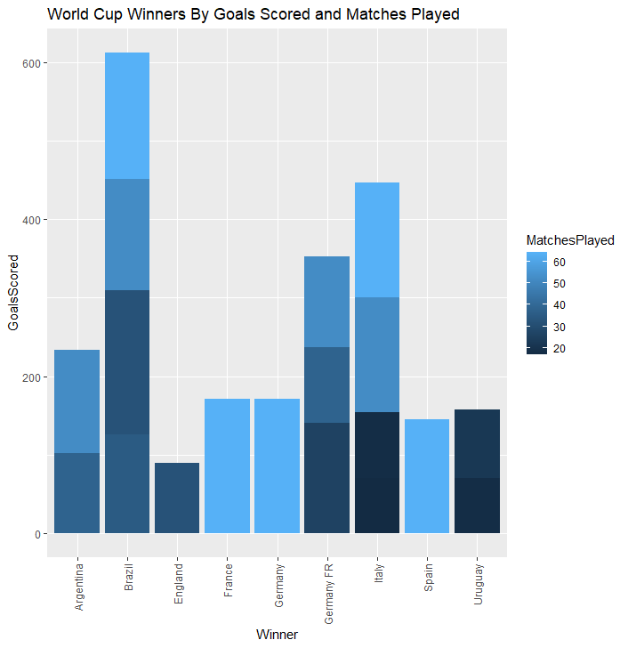
R – Stacked Bar Chart

Slide 8
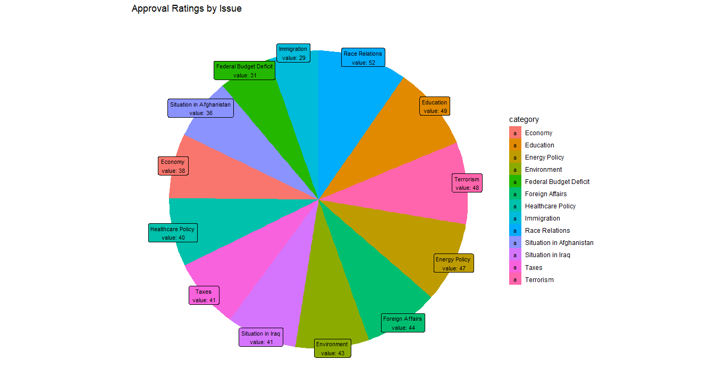
R – Pie Chart

Slide 9
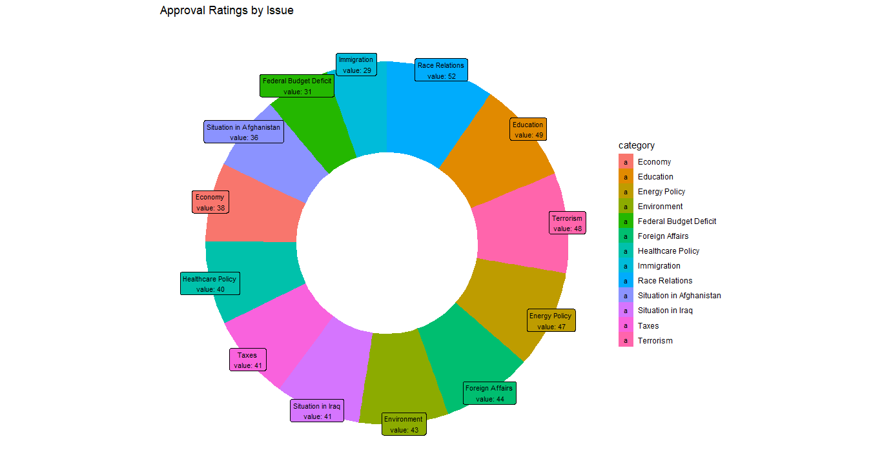
R – Donut Chart

Slide 10
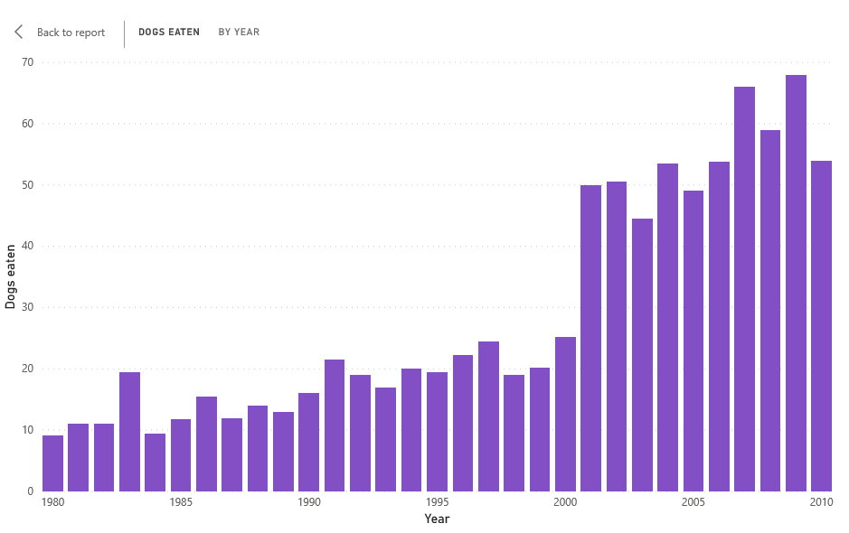
Power BI – Bar Chart

Slide 11
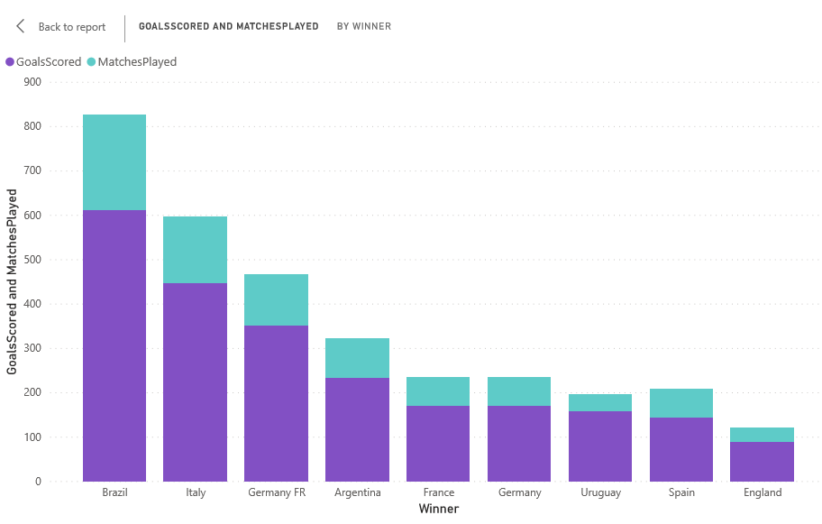
Power BI – Stacked Bar Chart

Slide 12
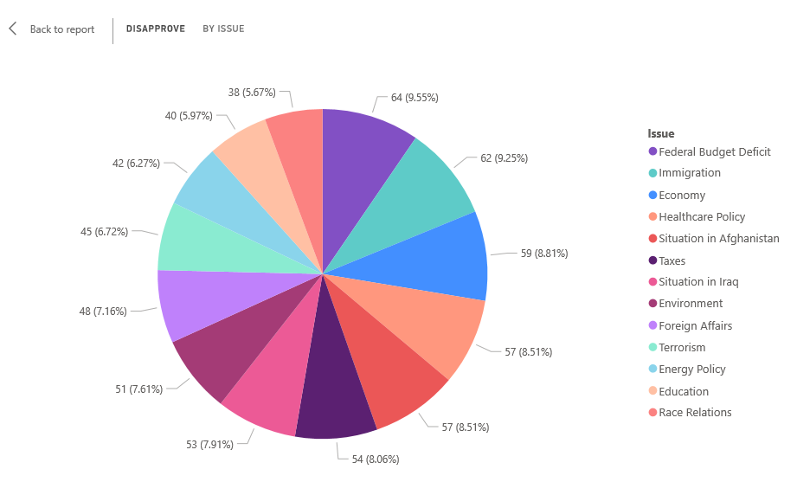
Power BI – Pie Chart

Slide 13
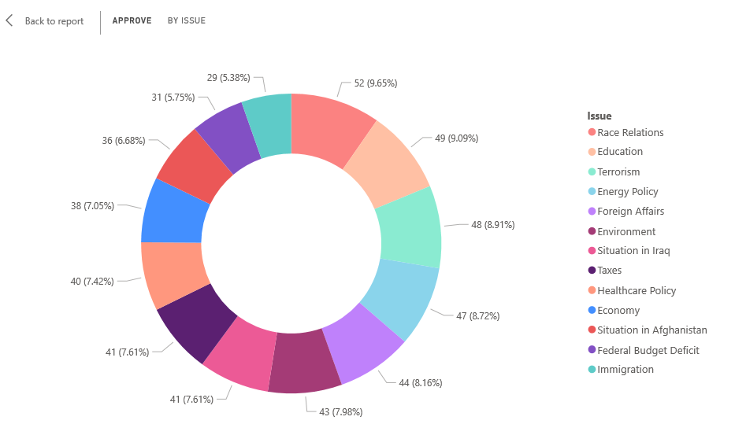
Power BI – Donut Chart

Slide 14
References
Fifa World Cups from Kaggle: https://www.Kaggle.com/abecklas/fifa-world-cup?select+WorldCups.csv
Hotdog Winners Contest dataset that was provided in Exercise 1.2 Datasets zipped file
Obama Approval Ratings dataset that was provided in Exercise 1.2 Datasets zipped file
Python Pie Chart Code Reference: https://datatofish.com/pie-chart-matplotlib/
Python Donut Code Reference: https://gist.github.com/krishnakummar/ad00d05311977732764f
R Pie and Donut Chart Code Reference: https://www.r-graph-gallery.com/128-ring-or-donut-plot.html

